Slide 1
Fast Volume Rendering with Spatiotemporal Reservoir Resampling
Zhihao Ruan (ruanzh@seas.upenn.edu)
Shubham Sharma (sshubh@seas.upenn.edu)
Raymond Yang (rayyang@seas.upenn.edu)

Slide 2
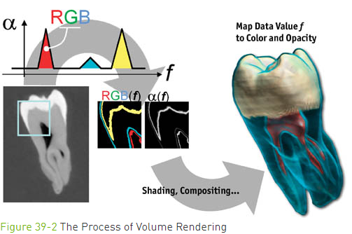
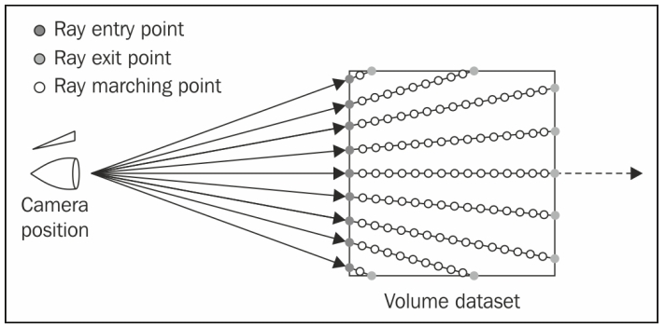
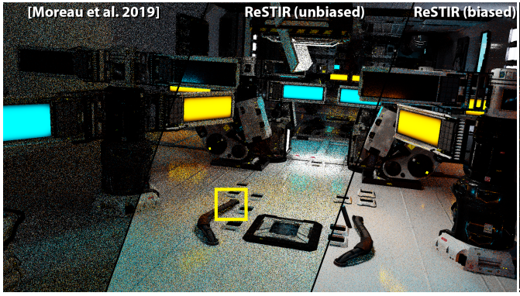
Since Last Milestone Pt.1
Overview of Volume Rendering
Overview of Spatiotemporal Reservoir Resampling

Slide 3
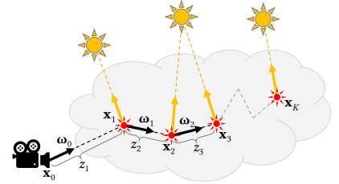
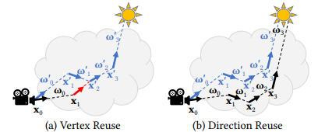
Since Last Milestone Pt.2
Overview of Fast Volume Rendering with Spatiotemporal Reservoir Resampling (Volume Rendering + ReStir)
Optimizations:

Slide 4
For This Milestone Pt.1
Vulkan Pipeline with VK-Bootstrap
Optimizes Instance Creation, Physical Device selection, Device Creation, Getting Queues, Swapchain Creation
Improves Enabling Validation Layers, Debug Callback
Abstraction between physical and logical layer
OpenVDB
Single threaded approach to extracting volumetric data

Slide 5
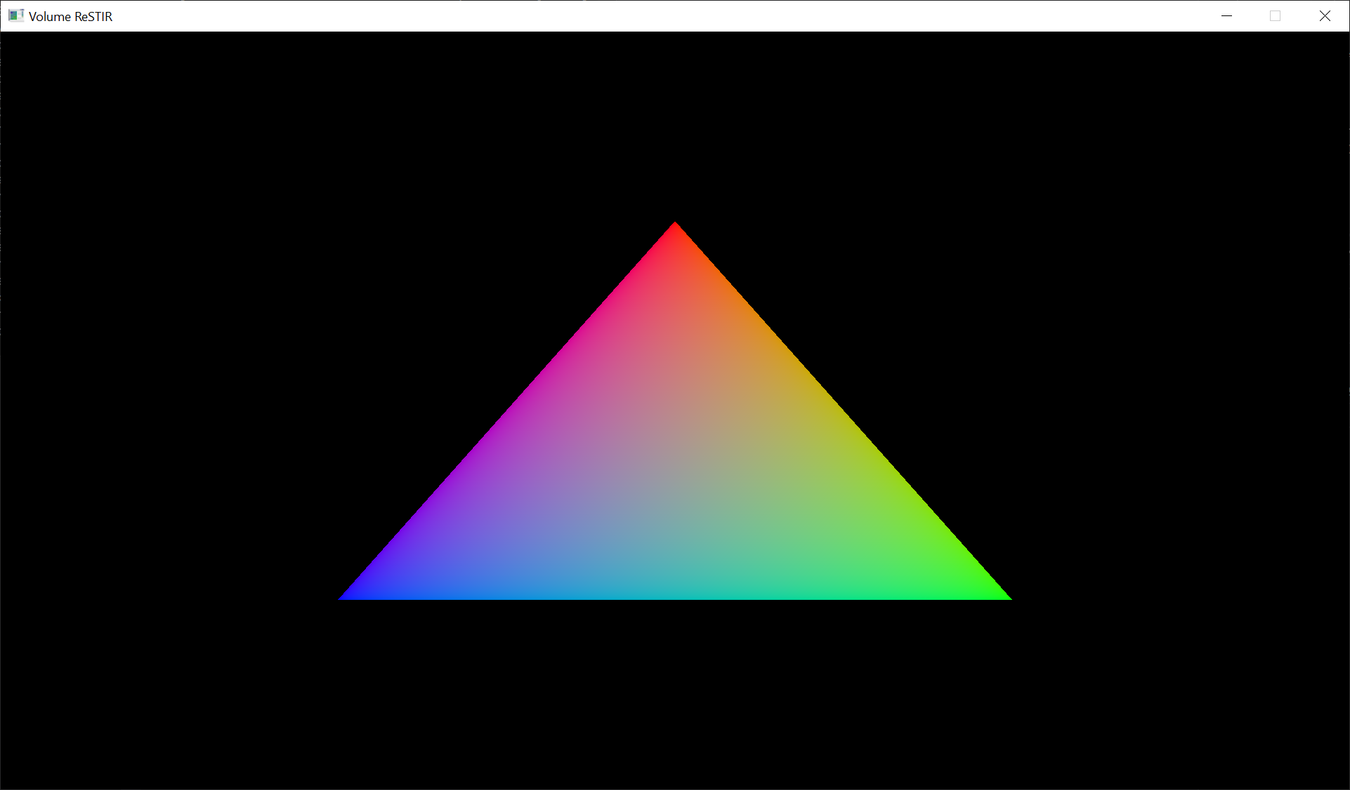
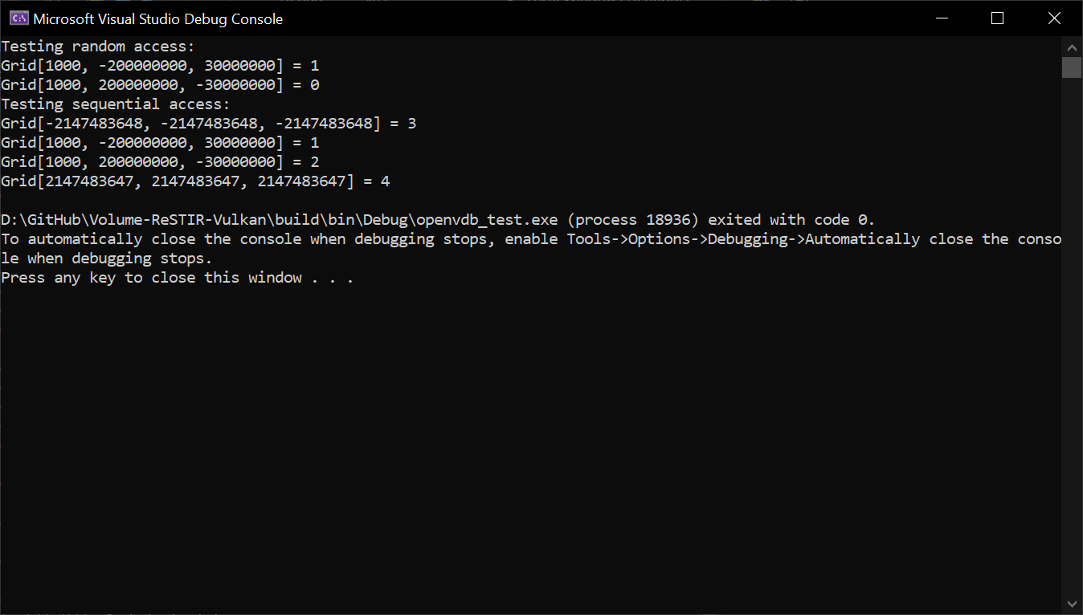
For This Milestone Pt.2
Vulkan Pipeline
OpenVDB

Slide 6
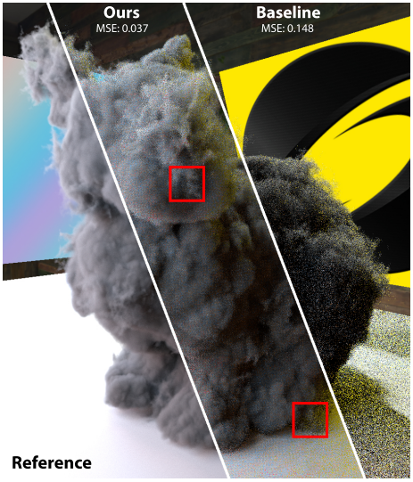
For Next Milestone
Concrete understanding of Restir and Volume Rendering + ReStir
Implement a basic Fast Volume Rendering with ReStir with working toy example

Slide 7
References and Credit
[1] Volume Rendering
[2] Volume Rendering (Nvidia)
[3] Fast Volume Rendering with Spatiotemporal Reservoir Resampling (SIGGRAPH 2021)
[4] Spatiotemporal reservoir resampling for real-time ray tracing with dynamic direct lighting (SIGGRAPH 2020)
[5] VK-Bootstrap
[6] OpenVDB

